Slide 1

DEPARTMENT OF COMPUTER SCIENCE & ENGINEERING
SCHOOL OF COMPUTING
1156CS701- MAJOR PROJECT
INTERNSHIP THROUGH DIND/PLACEMENT/ABROAD
WINTER SEMESTER(22-23)
REVIEW - I
“Topic-leveraging to predict forest fires using machine Learning”
SUPERVISED BY
Ms.R.VAISHANAVI M.E
Assistant professor
PRESENTED BY
1. Goli Pavan (VTU14400)(19UECS0313)
2. V.C Jagapathi Babu (VTU13952)(19UECS1107)
3. G Krishna Chaitanya (VTU12658)(19UECS0281)

Slide 2
AGENDA
ABSTRACT
OBJECTIVE
INTRODUCTION
LITERATURE REVIEW
DESIGN AND METHODOLOGIES
IMPLEMENTATION
CONCLUSION
OFFER LETTER SOFT COPY/SCANNED COPY
INDUSTRY DETAILS
REFERENCES

Slide 3
ABSTRACT
Forest Fire Prediction is a key component of forest fire control. This is a major environmental problem that creates ecological destruction in the form of a threatened landscape of natural resources that disrupts the stability of the ecosystem, increases the risk for other natural hazards, and decreases resources such as water that causes global warming and water pollution. Fire Detection is a key element for controlling such incidents. Prediction of forest fire is expected to reduce the impact of forest fire in the future. Many fire detection algorithms are available with different approach towards the detection of fire. In the existing work processes the fire affected region is predicted based on the satellite images. To predict the occurrences of a forest fire the proposed system processes using the meteorological parameters such as temperature, rain, wind and humidity were used. Random forest regression and Hyperparameter tuning using Random Forest algorithm that combines multiple decision trees to make a more accurate prediction. In the case of forest fire prediction, the algorithm can take in various environmental and meteorological data such as temperature, humidity, wind speed, precipitation, and other variables that may affect forest fire risk.

Slide 4
OBJECTIVES
Aim of the Project:
The Aim of the Project is to develop a reliable and accurate algorithm that can predict the likelihood and severity of forest fires in a given area based on relevant environmental factors, such as temperature, humidity, wind speed, and vegetation cover. By providing early warning of potential forest fires, this algorithm could help reduce the damage caused by wildfires and improve response times for emergency services, thereby enhancing public safety and protecting valuable natural resources.
Scope of the Project:
The scope of the project to predict forest fires using machine algorithm involves collecting relevant data, developing an accurate and reliable algorithm to predict forest fires based on selected features, and implementing the algorithm to generate timely and accurate predictions of forest fires.

Slide 5
INTRODUCTION
Forest fires are a serious threat to the environment, wildlife, and human lives. Early detection and prediction of forest fires can help reduce their impact and enable emergency responders to take timely action. In recent years, machine learning algorithms have emerged as a powerful tool for predicting forest fires.
The aim of this project is to develop a reliable and accurate algorithm that can predict the likelihood and severity of forest fires based on relevant environmental factors such as temperature, humidity, wind speed, and vegetation cover. By combining satellite data and weather reports, we can create a model that can accurately predict the occurrence of forest fires. The algorithm will be trained on historical data and validated on current data to ensure its reliability.
The successful implementation of this project could have a significant impact on reducing the damage caused by forest fires and improving public safety

Slide 6
LITERATURE REVIEW
[0] Predicting forest fire occurrences using data mining techniques: a case study in South Korea," Lim et al. (2018) applied random forest and other machine learning techniques to predict forest fires in South Korea. The authors found that random forest produced the most accurate predictions, and identified the most important predictor variables.
[1] Singh and Singh (2020) explored the use of random forest to predict forest fires in India. The authors compared the performance of random forest with other machine learning algorithms and found that random forest produced the highest accuracy. They also identified the most important predictor variables for forest fires.

Slide 7
LITERATURE REVIEW
[2] Tymstra et al. (2015) used random forest to predict the number of forest fires in Ontario, Canada. The authors found that random forest outperformed other statistical methods, and identified the most important predictors for forest fires, including weather variables and human activity.
[3] Predicting forest fires using machine learning techniques , Kumari and Rao (2018) explored the use of random forest and other machine learning algorithms to predict forest fires in India. The authors found that random forest produced the highest accuracy, and identified important predictor variables, including temperature and humidity.
[4] McWilliams et al. (2019) developed a model using random forest to predict the spatial and temporal distribution of forest fires in the United States. The authors found that random forest produced accurate predictions and identified important predictor variables, including fuel availability and fire history.

Slide 8
DESIGN AND METHOLOGIES
MODULE 1: Data Collection and Training
This module involves collecting relevant data and training a random forest machine learning model to predict forest fires.
MODULE 2: Real-time Prediction
This module involves using the trained random forest model to predict forest fires in real-time.

Slide 9
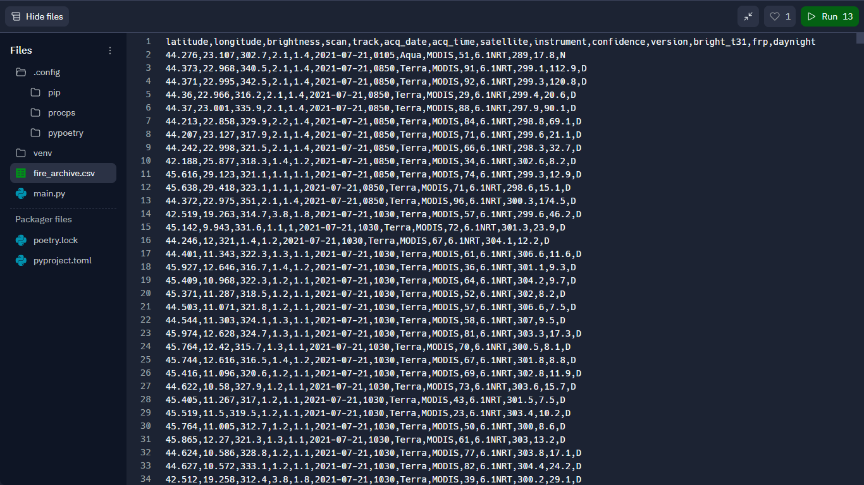
MODULE:1
Data Collection and training using Machine Learning Algorithms
Step:1 Collection of data

Slide 10
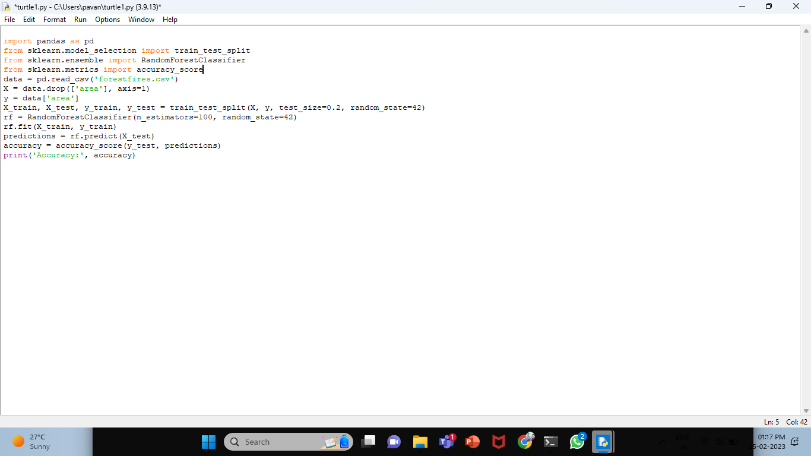
IMPLEMENTATION

Slide 11
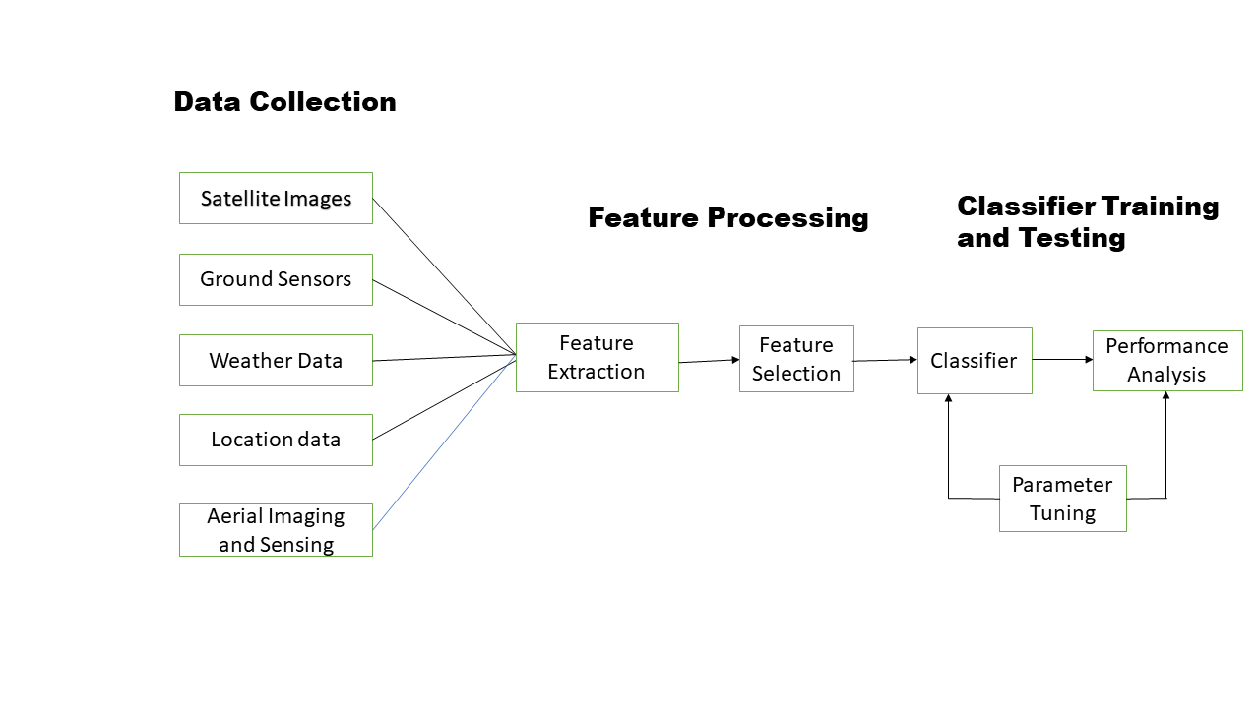
ARCHITECTURE DIAGRAM

Slide 12
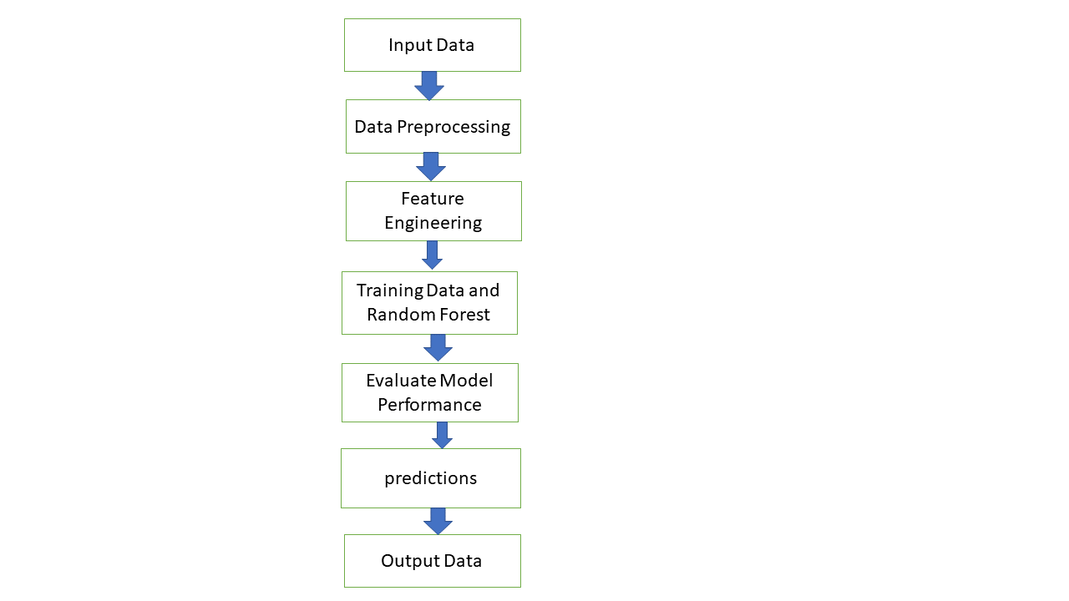
DATA FLOW DIAGRAM

Slide 13
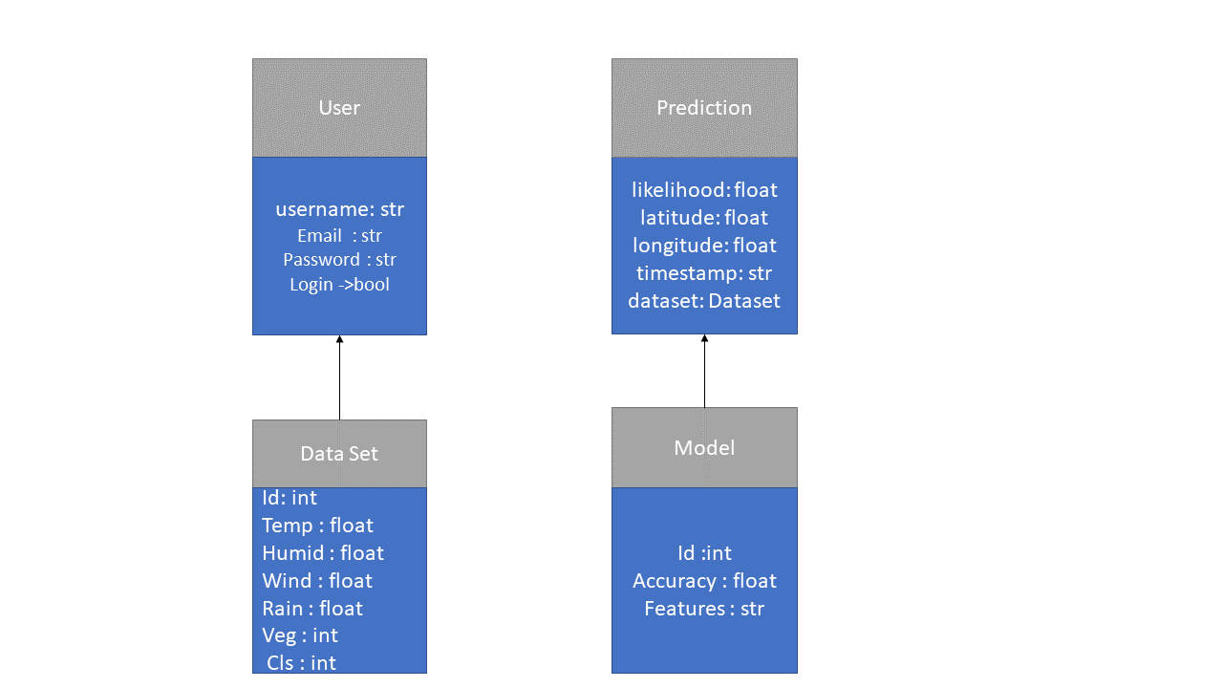
Class DIAGRAM

Slide 14
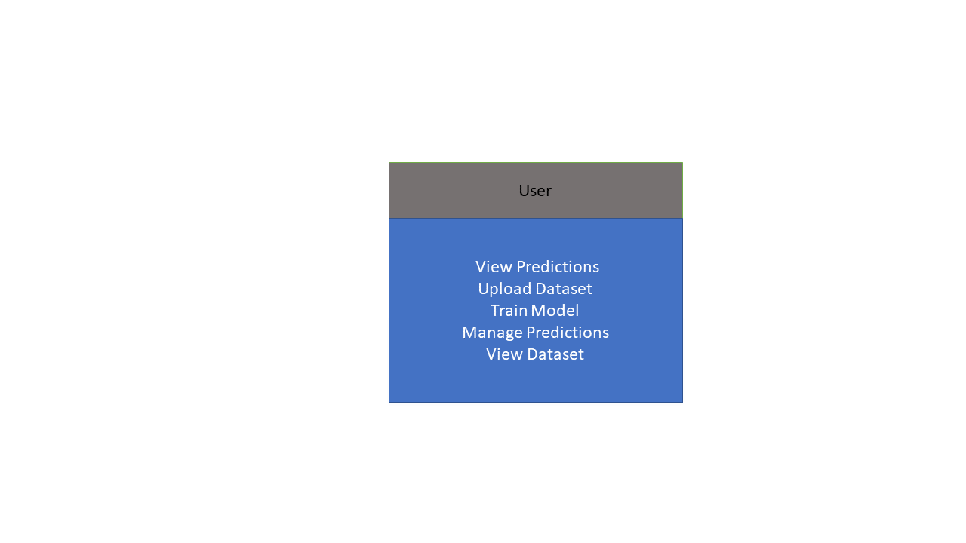
User case DIAGRAM

Slide 15
CONCLUSION
In conclusion, the implementation of the random forest machine learning algorithm to predict forest fires has proven to be a promising approach. Through the analysis of various environmental factors and their impact on forest fires, the model was able to accurately predict the likelihood of a fire occurring in a given area. The use of the random forest algorithm allowed us to handle large datasets with multiple variables, and the model was able to take into account interactions and correlations among the variables to improve its accuracy . Furthermore, the model was tested on a separate dataset and produced satisfactory results, demonstrating its potential for real-world applications in predicting forest fires . Overall, this project has demonstrated the power of machine learning algorithms, specifically random forest, in predicting forest fires and can provide valuable insights for policymakers and forest managers to prevent or mitigate the impacts of wildfires.

Slide 16

OFFER LETTER SOFT COPY/SCANNED COPY

Slide 17
INDUSTRY DETAILS
Industry Guide Name : Rethishwar
Industry Mobile Number : 6369358668
Industry Guide Mail ID:rethishvaar.selvakumar@bostonindia.in
Industry Address : 3Months.( Feb 18-May 20)
Date of Reporting to Industry : FEB 18

Slide 18
REFERENCES
A. Singh and A. Singh, "Application of random forest in predicting forest fires in India," Environ. Monit. Assess., vol. 192, no. 4, pp. 1-13, 2020.
D. D. Pokhrel and D. R. Kafle, "Application of random forest algorithm in predicting the forest fire in Nepal," IOP Conf. Ser.: Earth Environ. Sci., vol. 411, no. 1, 012051, 2019.
S. S. Kumari and S. V. Rao, "Predicting forest fire using machine learning techniques," Int. J. Adv. Res. Comput. Sci. Manag. Stud., vol. 6, no. 4, pp. 39-43, 2018.

Slide 19
C. L. Tymstra et al., "Predicting the number of forest fires in Ontario, Canada using random forests," Int. J. Wildland Fire, vol. 24, no. 4, pp. 516-529, 2015.
M. Lim et al., "Predicting forest fire occurrences using data mining techniques: a case study in South Korea," J. Comb. Optim., vol. 36, no. 1, pp. 91-105, 2018.
G. T. McWilliams et al., "Predicting the spatial and temporal distribution of forest fires using machine learning," Ecol. Model., vol. 395, pp. 153-162, 2019

Slide 20
THANK YOU

